Slide 1

E-COMMERCE ORDER MANAGEMENT SYSTEM
Capstone project review-1
BATCH NUMBER:11
Presented by:
25B11AI911-P.CHANDRIKA(AIML)
25B11AI332-G.ANVITHA(AIML)
25B11AI420-J.TANISHKA(AIML)
25B11AIB23-S.SUDHADEVI(AIML)
Academic Year: 2026-2027
Under esteemed guidance of
Dr P Kishorekumar
Associate Professor
Department of AIML
Aditya University

Slide 2

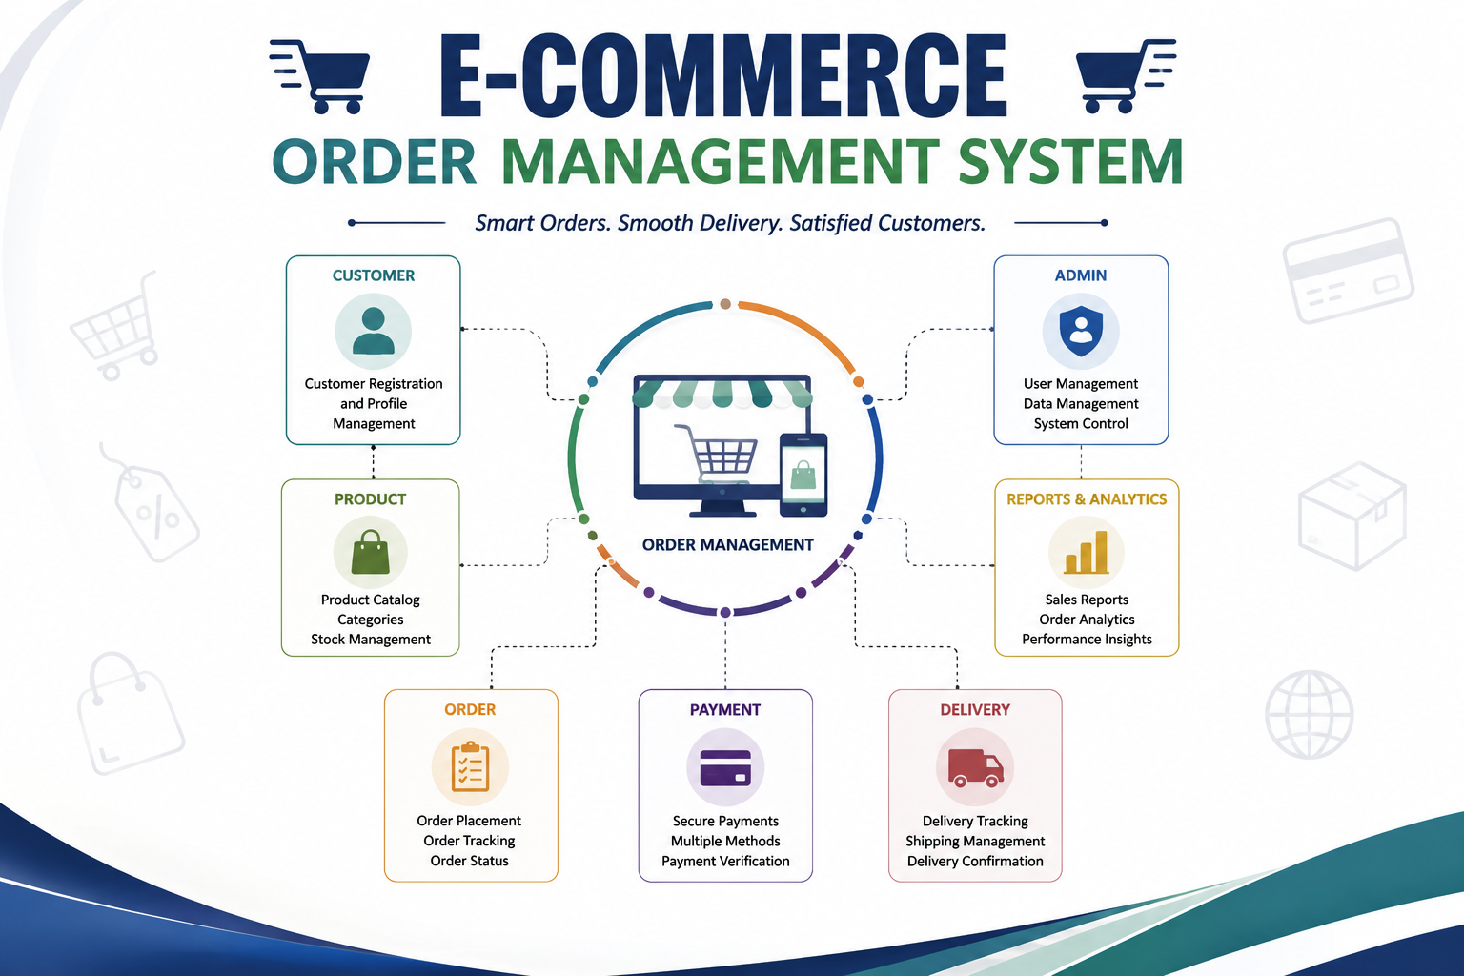



Outline
Introduction
Problem statement
Objectives
System scope
Entities and attributes
Relationships and Cardinality
Relational Database Schema
2

Slide 3
INTRODUCTION
INTRODUCTION
E-Commerce Order Management System is a database-based system designed to manage online shopping orders efficiently.
It stores and organizes information about customers, products, orders, payments, and deliveries.
It provides a structured way to manage the complete order process, from placing an order to final delivery.
It helps maintain accurate and consistent order-related information.
It reduces manual work and avoids duplication of customer and order records.
It organizes e-commerce data using well-defined entities and relationships.
It helps track product details, customer orders, payment information, and delivery status.
The project mainly focuses on database design for Review–I, while implementation can be carried out in the next review.
2

Slide 4
PROBLEM STATEMENT
E-commerce platforms handle a large number of customers, products, and orders every day.
Poorly structured record management can cause duplicate data and incorrect order details.
Separately maintained customer, product, payment, and delivery records make order management difficult.
Lack of proper relationships between records makes complete order information difficult to retrieve.
The proposed system creates a centralized database connecting customers, products, orders, payments, and deliveries.
The system aims to maintain accurate, consistent, and easily accessible order information throughout the order lifecycle.
3

Slide 5
OBJECTIVE
Centralize E-Commerce Data: Organize customer, product, order, payment, and delivery information in a structured database.
Simplify Order Processing: Maintain the complete order journey from order placement to successful delivery.
Improve Order Tracking: Track order status and delivery progress accurately.
Ensure Data Accuracy: Reduce duplicate records and maintain consistent information across the system.
Connect Related Records: Establish meaningful relationships between customers, products, orders, payments, and deliveries.
Enable Quick Information Retrieval: Make customer, product, and order details easy to access whenever required.
4

Slide 6
SYSTEM SCOPE
Customer Management
Customer details, contact information, and account records
Product management
Product details, categories, prices, and stock information
Order Management
Order details, order dates, quantities, and order status
Payment Management
Payment details, payment methods, and transaction status
Delivery Management
Delivery details, shipping information, and delivery status
Order Tracking
Tracking order progress from order placement to final delivery
5

Slide 7
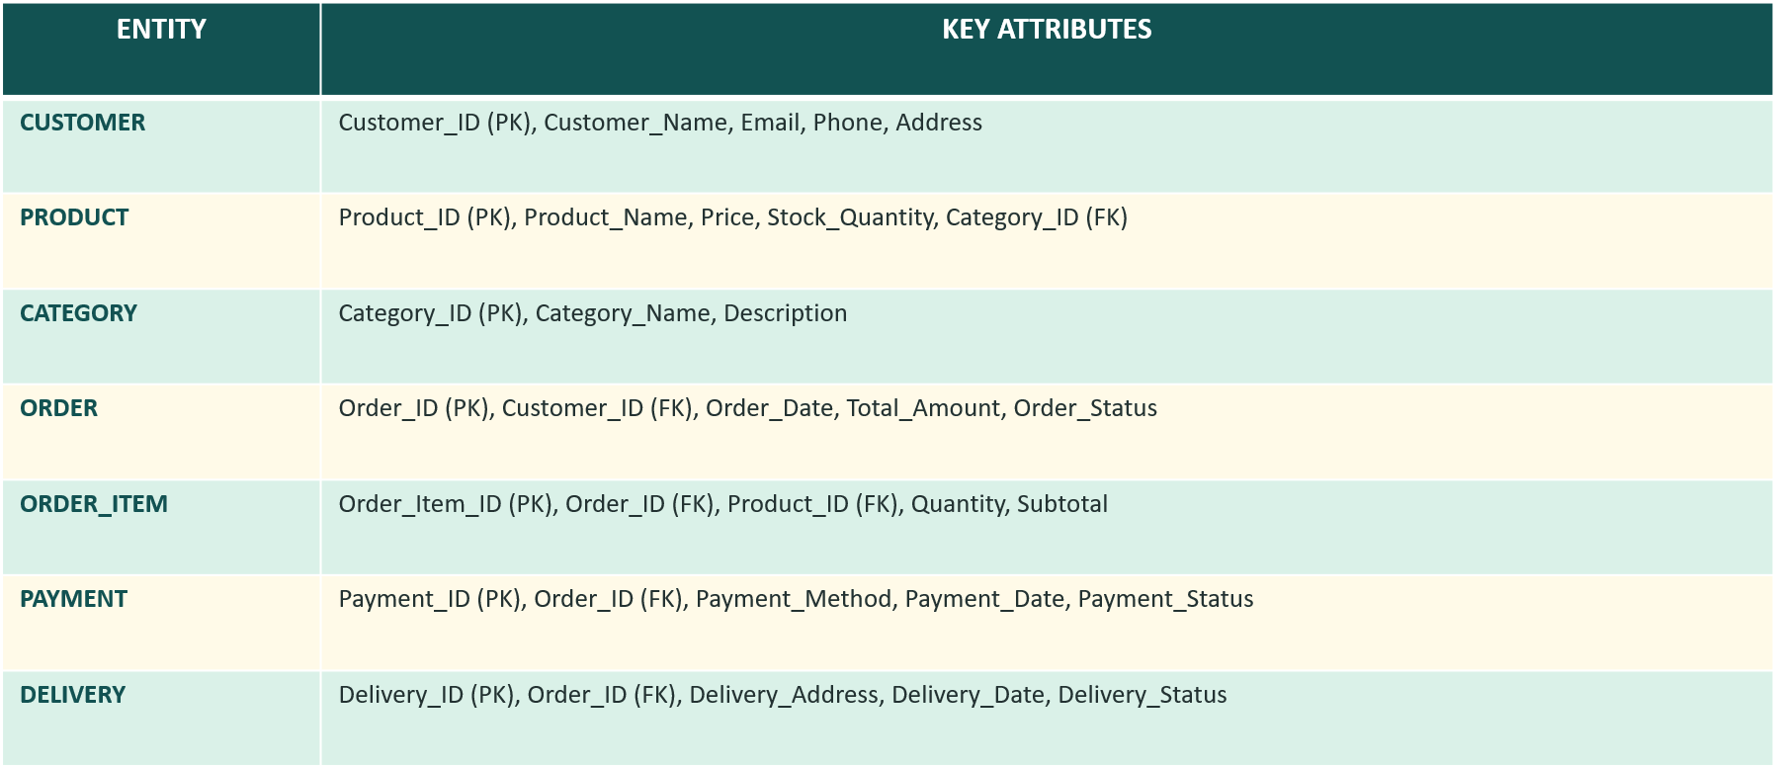
ENTITIES AND ATTRIBUTES
Seven entities identified for the proposed E-Commerce Order Management System

Slide 8
RELATIONAL DATABASE SCHEMA
CUSTOMER | Customer(CUSTOMER_ID, CUSTOMER_NAME, Email, Phone, Address) | PK: STUDENT_ID | FK: DEPARTEMENT_ID
CATEGORY | Category(CATEGORY_ID, CATEGORY_NAME, Description) | PK: CATEGORY_ID
PRODUCT | Product(Product_ID, PRODUCT_NAME, Price, STOCK_QUANTITY, CATEGORY_ID) | PK: PRODUCT_ID | FK: CATEGORY_ID
ORDER | Order(ORDER_ID, CUSTOMER_ID, ORDER_DATE, TOTAL_AMOUNT, ORDER_STATUS) | PK: ORDER_ITEM_ID | FK:ORDER_ID
ORDER_ITEM | ORDER_IITEM(ORDER_ITEM_ID, ORDER_ID, Product_ID, Quantity, Subtotal) | PK: ORDER_ID | FK: ORDER_ID, PRODUCT_ID
PAYMENT | Payment(PAYMENT_ID, ORDER_ID, PAYMENT_METHOD, PAYMENT_DATE, PAYMENT_STATUS) | PK: PAYMENT_ID | FK: ORDER_ID

Slide 9
RELASHIONSHIPS AND CARDINALITY
Relationship | Cardinality | Meaning
Customer – Order | 1 : M | One customer can place many orders..
Category – Product | 1 : M | One category can contain many products.
Order – Order Item | 1 : M | One order can contain many order items.
Product – Order Item | 1 : M | One product can appear in many order items.
Order – Payment | 1 : 1 | One order has one payment record.
Order – Delivery | 1 : 1 | One order has one delivery record.
Customer – Address | 1 : M | One customer can have many addresses.
7

Slide 10
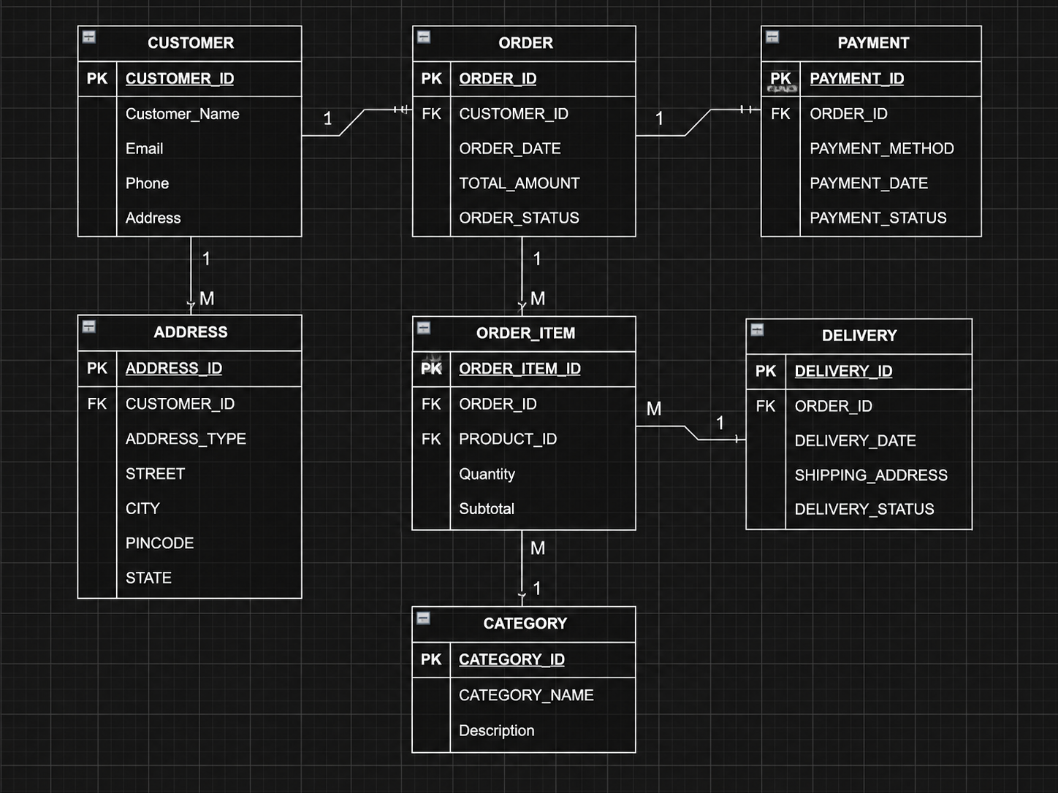
ER - DIAGRAM
Conceptual database design – six entities and their relationships

Slide 11

10

Slide 12
COCLUSION
Provides a centralized database for managing e-commerce information efficiently.
Connects customers, products, orders, payments, deliveries, and addresses through defined relationships.
Helps maintain accurate and consistent order-related records.
Simplifies the process of placing, processing, tracking, and delivering orders.
Reduces data duplication and manual record management.
The identified primary keys and foreign keys maintain data integrity between tables.
The relational schema provides a structured foundation for future implementation.
The proposed design can be extended with features such as returns, reviews, offers, and order analytics.
Overall, the system provides a scalable and organized database foundation for an efficient e-commerce platform.
Review–I Focus: Order Management Database Design
11

Slide 13
Thank You

